Slide 1
Advanced Data Analysis
Fall 2016

Slide 2
IMPORTANT NOTICE! Due to over-enrollment, class open ONLY to Stat MA students who will graduate in Dec 2016. NO EXCEPTION! Stat MA and MAFN students must be in their last semester to take the course. The course will be offered in the Spring 2017 semester

Slide 3
Instructor:
E-mail: da15@columbia.edu
Office Hours: Friday: 5:00 PM - 6 PM,
and by appointment
TAs:
Lydia Hsu: yh2692@columbia.edu
Sihan Huang: sh3453@columbia.edu
Chaoyu Yuan: cy2438@columbia.edu
Prerequisites:
At least two applied stat courses: Stat GR5205 (Lin Reg), Stat GR5234 (Sample surveys), Stat GR5221 (Time Series), Stat GR5241(Stat Machine Learning), Stat GR5705 (Intro Data Sci), etc.

Slide 4
Course Objectives:
Emphasis on hands-on experience with data analysis, involving case studies and using common statistical packages.
Topics:
Exploratory data analysis
Basic stat procedures. Model formulation, goodness-of-fit testing
Standard and non-standard statistical procedures, including:
Linear regression,
Analysis of variance
Nonlinear regression
Generalized linear models
Survival analysis
Time series analysis
Bayesian methods
Data mining techniques

Slide 5
Project:
Students will be asked to propose a data set, with the approval of the instructor, define a research problem, develop an analysis plan, and submit a report at the end of the semester.
Only original projects will be accepted
Students expected to work in groups of 5-10 students
Groups should be formed by September 15th , and the names of members listed on the first sheet at:
https://docs.google.com/spreadsheets/d/13WF9aqeShbmvpZlauPtJBBkcPn5WOgzEt56JqbbE1qU/edit#gid=70905545
Each group will choose a date for the presentation and sign up in the 2nd sheet (sign-up sheet named: Date/Time)
https://docs.google.com/spreadsheets/d/13WF9aqeShbmvpZlauPtJBBkcPn5WOgzEt56JqbbE1qU/edit#gid=1265912736
Each group to sign up in only one time slot. If all slots are full, sign up in the Waitlist column
During the presentation, each member of the group will be expected to participate and answer questions. The presenter will be selected at random from the group.
All students are expected to attend the presentations and participate in the discussions.

Slide 6
Project Team and Presentation Sign-up (Sheet 1)
Group | Name: Last, First | Name: Last, First | Name: Last, First | Name: Last, First | Name: Last, First | Name: Last, First | Name: Last, First | Name: Last, First | Name: Last, First | Name: Last, First | Name: Last, First
1 | ZZZ, YYY
2
3
4
5
6
7
8
9
10
11
12
13
14
15
16
17
18
19
20
21
22
23
24
25
26
https://docs.google.com/spreadsheets/d/1cIY0jfZNrrLJy6822Q5XvYGI7LUtV2FtAI4mO3rcUIE/edit#gid=70905545

Slide 7
Date/Time of Presentation: Sign-up (Sheet 2)
Date | Time | Group Number | Group Number/ Waitlist
9/23 | 7:50-8:00
 | 8:00 -8:10
 | 8:10-8:20
 | 8:20-8:30
9/30 | 7:50-8:00
 | 8:00 -8:10
 | 8:10-8:20
 | 8:20-8:30
10/7 | 7:50-8:00
 | 8:00 -8:10
 | 8:10-8:20
 | 8:20-8:30
 | ……. Cont.
https://docs.google.com/spreadsheets/d/13WF9aqeShbmvpZlauPtJBBkcPn5WOgzEt56JqbbE1qU/edit#gid=1265912736

Slide 8
Method of Evaluation:
Homework 30%.
Assigned weekly, on Fridays after class and is due the following Friday.
Homework should be turned in at designated boxes in Room 904, before 5 PM each Friday.
Midterm/Test 30%.
Date TBD
Project 40%.
Due on Monday Dec 12, 2016; 5 PM.

Slide 9
Suggested Reference Books:
Because of the nature of the course, no single text book is required.
However, the following text is suggested:
The Statistical Sleuth: A Course in Methods of Data Analysis. Ramsey & Schafer Duxbury
RECOMMENDED:
Hastie, et al (2009): The Elements of Statistical Learning: Data Mining, Inference, and Prediction. http://statweb.stanford.edu/~tibs/ElemStatLearn/
Introduction Time Series and Forecasting Brockwell & Davis. Springer-Verlag
The following are also useful references
Miller, R. Survival Analysis. 1981, Wiley
McCullagh and Nedler. Generalized Linear Models. Chapman/Hall.
Hosmer and Lemshow. Applied Logistic Regression, Wiley
Neter, Wasserman and Kutner. Applied Linear Statistical Models. Wiley.

Slide 10
GSAS Sample Statement on Academic Integrity
 |  | Columbia's intellectual community relies on academic integrity and responsibility as the cornerstone of its work. Graduate students are expected to exhibit the highest level of personal and academic honesty as they engage in scholarly discourse and research. In practical terms, you must be responsible for the full and accurate attribution of the ideas of others in all of your research papers and projects; you must be honest when taking your examinations; you must always submit your own work and not that of another student, scholar, or internet source. Graduate students are responsible for knowing and correctly utilizing referencing and bibliographical guidelines. When in doubt, consult your professor. Citation and plagiarism-prevention resources can be found at the GSAS page on Academic Integrity and Responsible Conduct of Research (http://gsas.columbia.edu/academic-integrity). Failure to observe these rules of conduct will have serious academic consequences, up to and including dismissal from the university. If a faculty member suspects a breach of academic honesty, appropriate investigative and disciplinary action will be taken following Dean's Discipline procedures (http://gsas.columbia.edu/content/disciplinary-procedures). http://gsas.columbia.edu/content/sample-statement-academic-integrity

Slide 11
Ground Rules
Attendance mandatory
surprise quizzes may be given to encourage attendance
No cellphones, web surfing or chatting during lecture
No late homework or make-up test or project
All homework and tests should reflect individual effort
Projects may be done in groups of 5-10.
Active participation in class expected
Questions and answers
Project presentation: Mandatory for all group projects
For group projects, each group member is expected to present in class

Slide 12
Generating and Summarizing Data
Experiments: Performed to generate
data to help make decisions.
Clinical Research: Is a new therapy superior to the standard?
Genetics: Is there any association between genetic make-up and occurrence of a certain type of disease?
Agriculture: What is the effect of soil types on crop yield?
Finance: What factors affect the performance of a company's stock?
Weather: What is the forecast in the next quarter?

Slide 13
Generating and Summarizing Data (cont’d)
Political Science: How do the polls predict election results?
Game Theory: Why does the casino make a profit at a roulette?
Manufacturing: What is the reliability of a certain manufacturing process?
Demography: What is the growth rate of a population in a given region?
Big Data?

Slide 14
Aspects of Big Data
Variety
Volume
Velocity
High dimensional
Data characteristics: Numeric/non-numeric
Computational issues
Quality?
Variability
Structure?
Storage?

Slide 15
Types of Studies
Controlled
Observational studies

Slide 16
Types of Studies
Randomized, controlled, double-blind
Randomization guards against selection bias
Ensures that groups are comparable.
Double-blind: Minimizes bias, either in the response or in the evaluation of the experimental outcomes.
Observational studies:
Assignment of experimental subjects to study groups not done by the investigator.
May lack advantages of controlled trials
May help establish association when RCTs not feasible

Slide 17
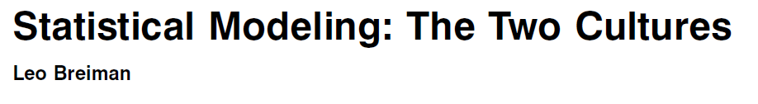

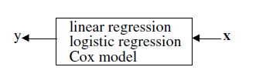
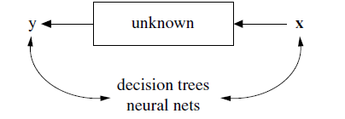
Data Analysis Paradigms
Stochastic Models vs. Algorithmic Models
Knowledge of mechanism generating data
“… data characteristics are rapidly changing. In many of the most interesting problems, the idea of starting with a formal model is not tenable.”
-Leo Breiman (2001)
“Automatic methods of model selection … are to be shunned or, if use is absolutely unavoidable, are to be examined carefully for their effects on the final conclusions.” ..
-DR Cox (2001)

Slide 18

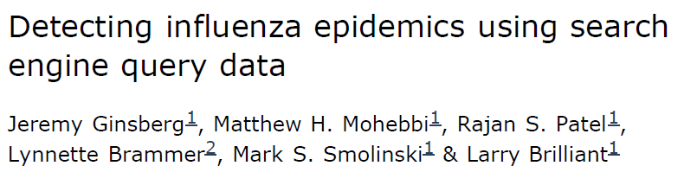
Example: Google Flue Trends (GFT)
2009: Google published GFT in Nature:
Predicted trend without use of medical check-up data
Could do it more quickly than the CDC: GFT a day’s delay vs. a week or more CDC needed to get reports from doctors’ offices
GFT theory-free, all algorithmic based
Nature (2009) 457, 1012-1014

Slide 19
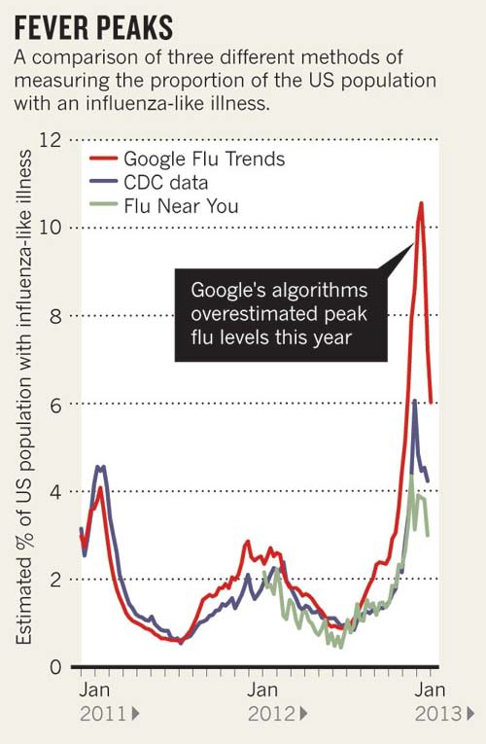
Example: Google Flue Trends (GFT)
“When Google got flu wrong”
Nature Volume: 494, Pages: 155–156
Date published: (14 February 2013)
DOI: doi:10.1038/494155a
2013: GFT predicted a severe flu outbreak but CDC data showed GFT’s estimates overstated by almost a factor of two.

Slide 20
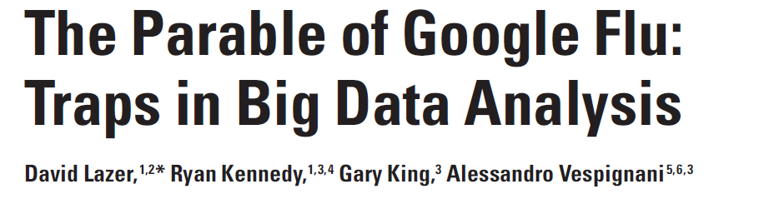
GFT Fiasco: What Went Wrong?
“Big data hubris” is the often implicit assumption that big data are a substitute for, rather than a supplement to, traditional data collection and analysis. ….
However, quantity of data does not mean that one can ignore foundational issues of measurement and construct validity and reliability and dependencies among data. …..

Slide 21
Questions to Ask in Data Analysis
What is the objective of the analysis and/or the original experiment?
What was the design of the study?
Randomized controlled or observational?
If a controlled trial, how were subjects assigned to the different groups?
Was the assignment process controlled by the investigator?
If an observational study: Are the groups comparable? What factors are confounded with treatment?
What procedure would be appropriate for the data?
Exploratory data analysis techniques?
Inferential statistical techniques?
Model building?
Implementation of analysis plan?
Interpretation of Results?
Are the results relevant?

Slide 22
Analysis Plan
Was the planned analysis followed?
If a large number of analyses are performed, some of them will be sure to show structure.
``If you torture the data long enough, they'll admit to anything"
Were assumptions validated?
Were there any confounding factors. If so, were appropriate measures taken?
Were multiple procedures/subgroup analyses performed?
If so, what adjustments were made for multiplicity?

Slide 23
Exploratory Data Analysis (EDA)
Preliminary look at data:
Evaluating data quality
Missing values
Outliers/Influential points
Checking assumptions: Distributions, relationships, etc.
Measures of location & dispersion

Slide 24
EDA cont.
Approaches:
Descriptive Statistics
Measures of location and dispersion
Graphical
Histograms, box-plots, Q-Q plots, etc.

Slide 25
EDA cont.
Measures of Location
Properties of the sample mean
It is easy to compute
It is easy to interpret/understand
Its variance has a simple expression
It is susceptible to outliers
Properties of the sample median:
Relatively more complex to compute and understand,
Strongly resistant to outliers.
Variability does not have a simple expression.

Slide 26

EDA cont.
Measures of Dispersion
Properties of the sample variance
Properties of the IQR, Range
Sampling distribution?

Slide 27
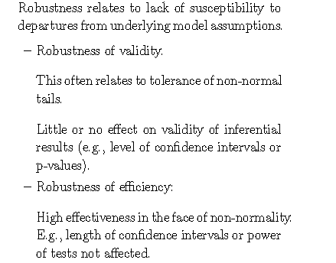
Robustness

Slide 28
Robustness (cont’d)
Breakdown Point
Fraction of data that could be made arbitrarily large, without making the estimator useless
Breakdown point for sample mean vs. median

Slide 29
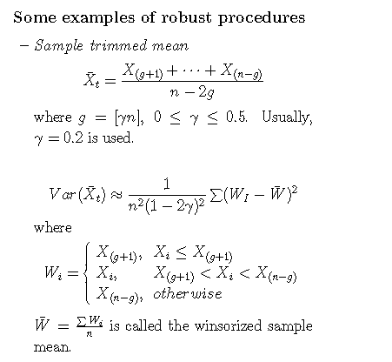

Slide 30
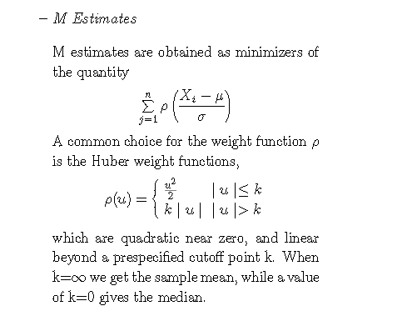

Slide 31
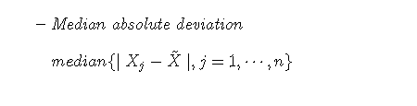

Slide 32
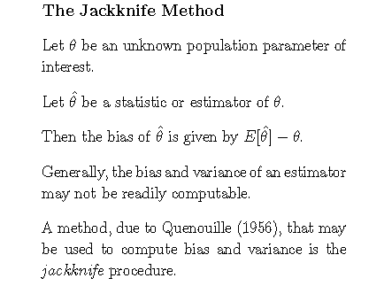

Slide 33
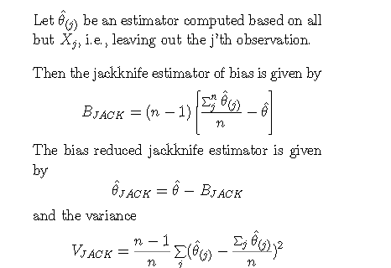

Slide 34
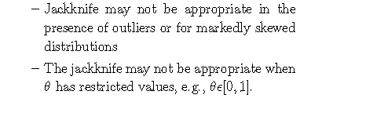
Caution in the use of the jackknife:

Slide 35
Computer-Intensive Statistical Methods
Monte Carlo Methods
Bootstrap Methods
Randomization Tests

Slide 36
Motivations
Classical statistics mostly based on idealized assumptions
Advance in computation helps replace complex theoretical analysis by computationally intensive methods

Slide 37
Monte Carlo Methods
Requirement:
Knowledge of the distribution to easily generate new samples
Example:
Simulate the sampling distribution of the interquartile range (IQR) of scores
Sampling distribution unknown

Slide 38
Procedure Monte Carlo Sampling: IQR
Let F be Normal(μ = 50, σ = 5).
Let S be the original sample of size N = 20 students, and let IQR = IQR(S) = 8.1 be our sample statistic.
2. Repeat i = 1 .. K times: a. Draw a pseudosample S _{i}* of size n from F by random sampling. b. Calculate and record IQR_{i}* = IQR(S _{i}*).
3. The distribution of IQR* is an empirical sampling distribution .

Slide 39
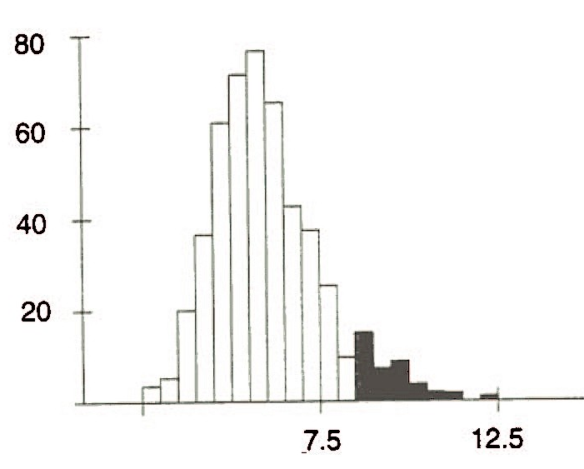
MC sampling distribution of IQRs for K = 500.
Dark: 40 scores greater than 8.1

Slide 40
Bootstrap Methods
Idea:
Now suppose F is arbitrary, unknown distribution.
Resample from the sample, treating the sample as the population.
The sample should be representative of the population.
Approximate sampling distribution of statistics based on corresponding pseudo-sample quantities.

Slide 41
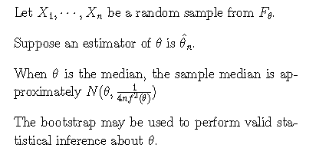

Bootstrap Methods (cont’d)

Slide 42
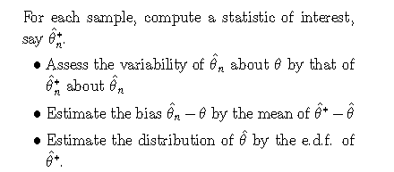
Bootstrap Methods (cont’d)

Slide 43
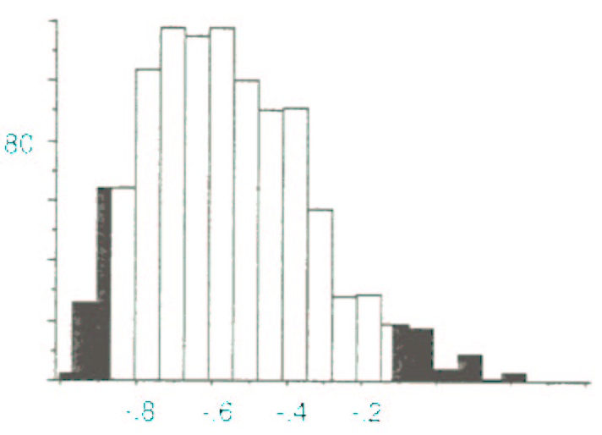
Bootstrapping the sample correlation coefficient
x | 5 | 1.75 | 0.8 | 5 | 1.75 | 5 | 1.75 | 1 | 5 | 1.75
y | 27.8 | 20.82 | 44.12 | 29.41 | 31.19 | 28.68 | 29.53 | 34.62 | 20 | 41.54
Bootstrap sampling distribution of r (K = 1000).

Slide 44
Remarks
In practice, the bootstrap works well in many situations, but not in all
Assumes: The original sample is representative of the population.

Slide 45
Randomization Tests
The bootstrap treats samples as “proxies” for populations.
Sometimes may wish to determine whether two samples are related without any reference to population parameters.

Slide 46
Randomization Tests (cont’d)
Example: Is the performance of this year’s students significantly more variable (IQR) than the performance of last year’s students?
48.35 | 53.93 | 55.48 | 45.67 | 52.82
49.47 | 57.00 | 53.61 | 57.69 | 51.34
44.98 | 54.70 | 59.32 | 51.70 | 50.73
46.84 | 63.13 | 52.50 | 49.67 | 54.07
44.84 | 48.68 | 53.94 | 59.00 | 50.92
Sample 1: last year
64.82 | 51.69 | 57.00 | 58.17 | 40.63
50.90 | 48.77 | 40.33 | 50.76 | 49.64
56.25 | 65.68 | 57.50 | 47.45 | 46.78
61.34 | 53.66 | 49.10 | 54.49 | 54.15
Sample 2: this year

Slide 47
Let d_{IQR} denote the difference between the IQRs of the samples, d_{IQR} = 6 - 8.5 = -2.5.
What is the probability that this difference occurs by chance?
Claim: students’ performance is no more variable this year than last.
If claim is really true, then randomly swapping scores between the samples will not influence d_{IQR} .

Slide 48
Approximate Randomization to Test Whether Two Samples Are Drawn from the Same Population
Let S_{A} and S_{B} be two samples of sizes n_{A} and n_{B}, respectively. Let θ = f(S_{A}, S_{B}) a statistic calculated from the two samples. Let S_{A+B} be the merge of S_{A} and S_{B}.
2. Do i = 1 … K times:
Shuffle the elements of S_{A+B} thoroughly.
Assign the first n_{A} elements of S_{A+B} to a randomized pseudosample A_{i}* and the remaining n_{B} elements to B_{i}*.
Calculate θ_{i}* = f(A_{i}*, B_{i}*) and record the result.
3. The distribution of θ_{i}* can now be used to find the probability of the sample result θ under the hypothesis that the samples are drawn from the same population.

Slide 49
Approximate randomization: K iterations do not exhaust the space of all possible assignments of elements of S_{A+B} to A_{i}* and B_{i}*.
Exact randomization: If can find exact probability by generating all possible outcomes.

Slide 50
Comparing Bootstrap and Randomization Procedures
Both generate the distribution of a statistic by resampling from the original sample.
Bootstrap resamples with replacement.
Randomization resamples without replacement.
Bootstrap simulates the process of drawing samples from a population, while randomization does not.
They produce different distributions!
Randomization cannot be used to draw inferences about population parameters (e.g., confidence intervals).

Slide 51
Computer-Intensive vs. Parametric Procedures
Computer-intensive methods most desirable when:
No parametric sampling distribution exists for a statistic.
Assumptions of underlying a parametric test are violated and procedure not robust.

Slide 52
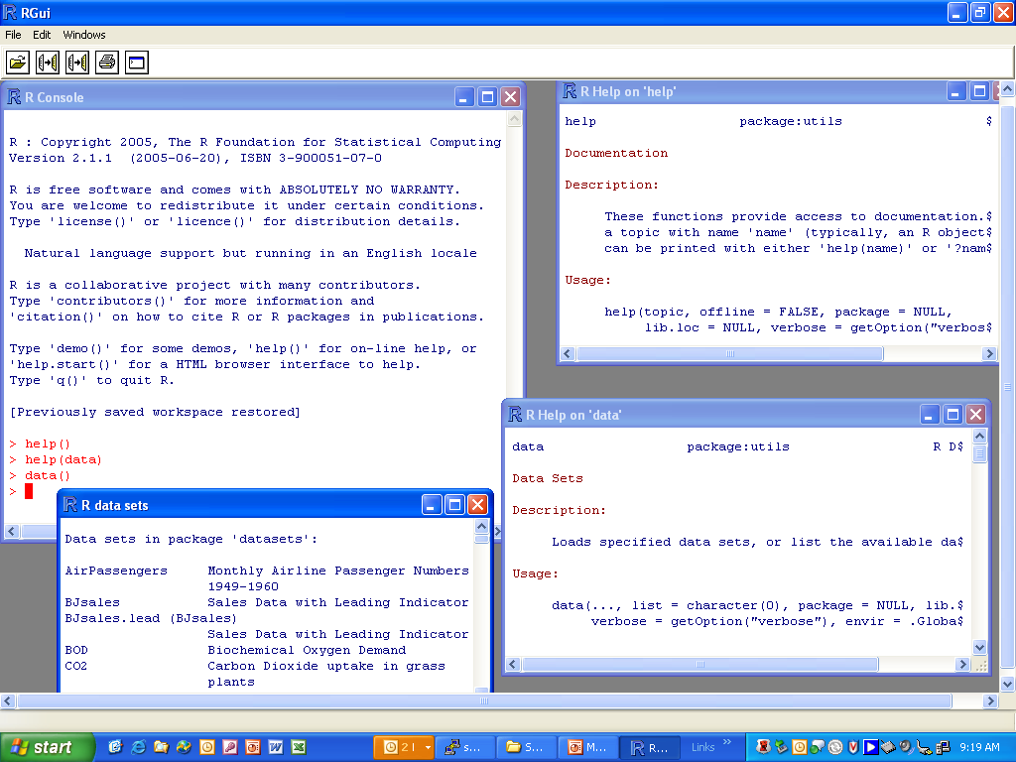

Slide 53
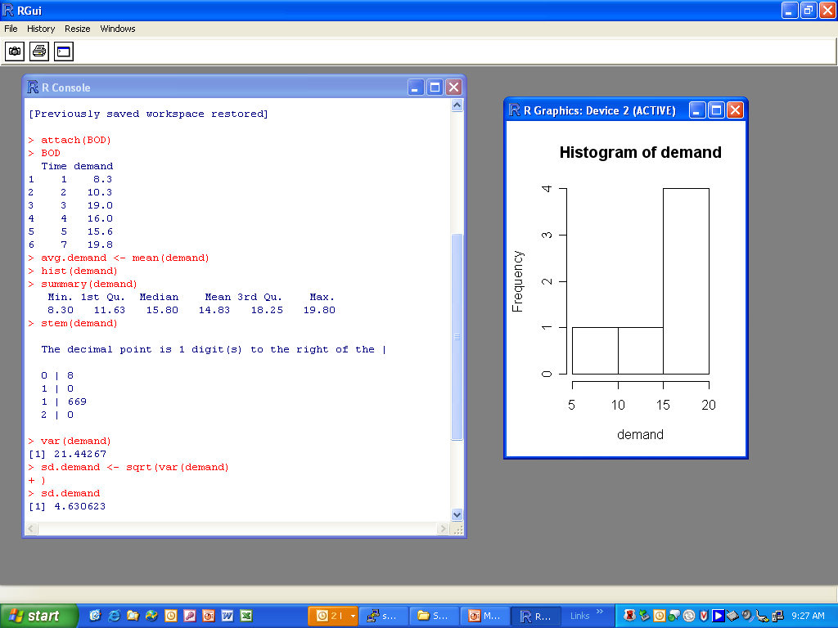

Slide 54
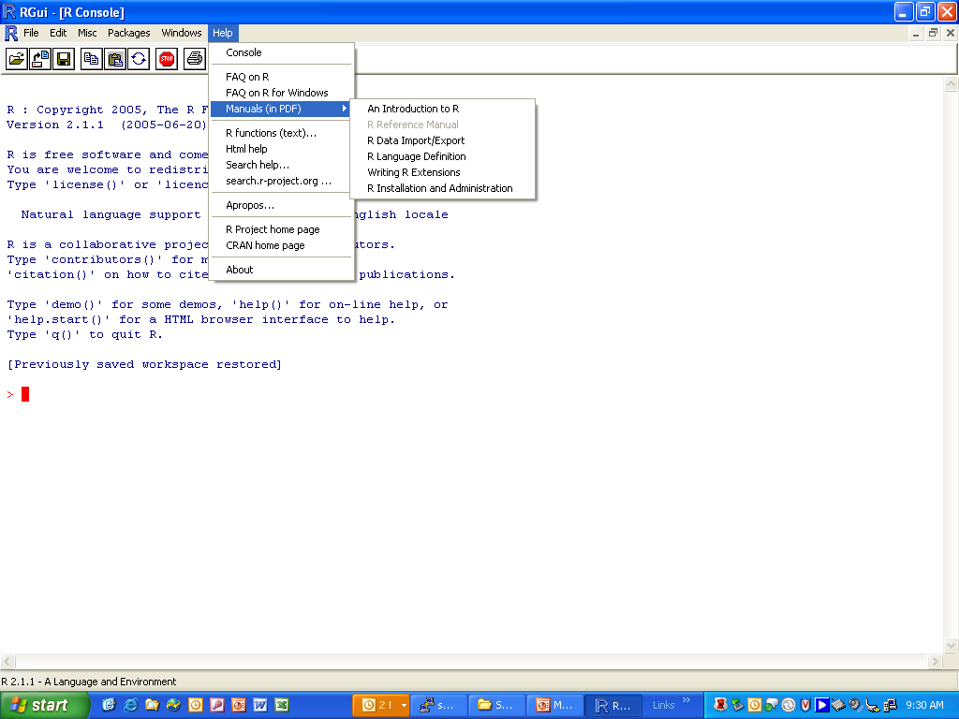
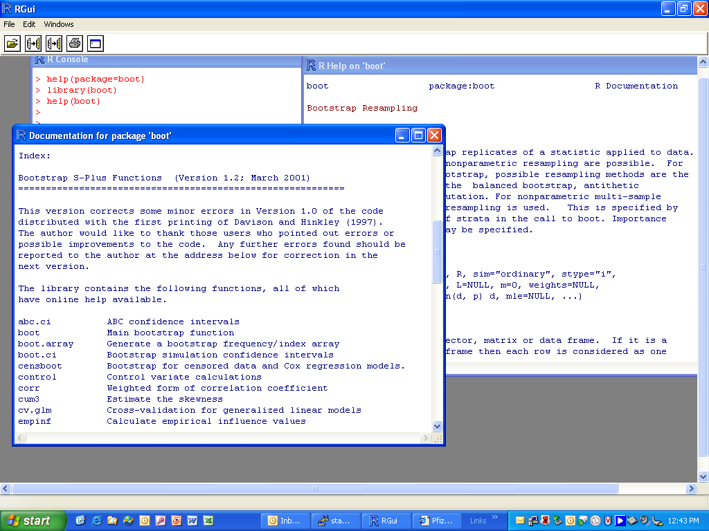

Slide 55
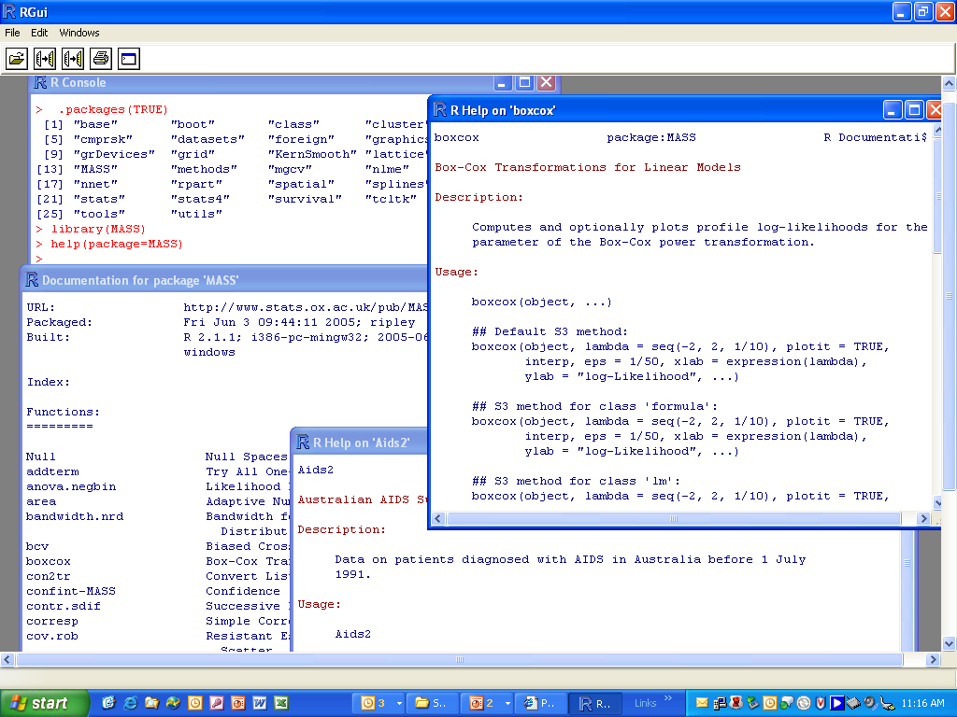

Slide 57
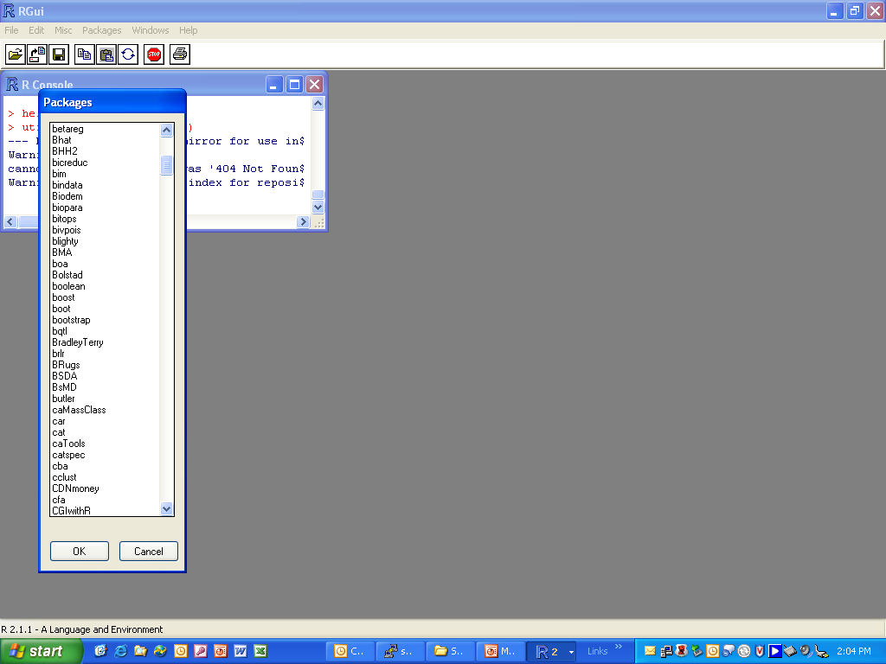
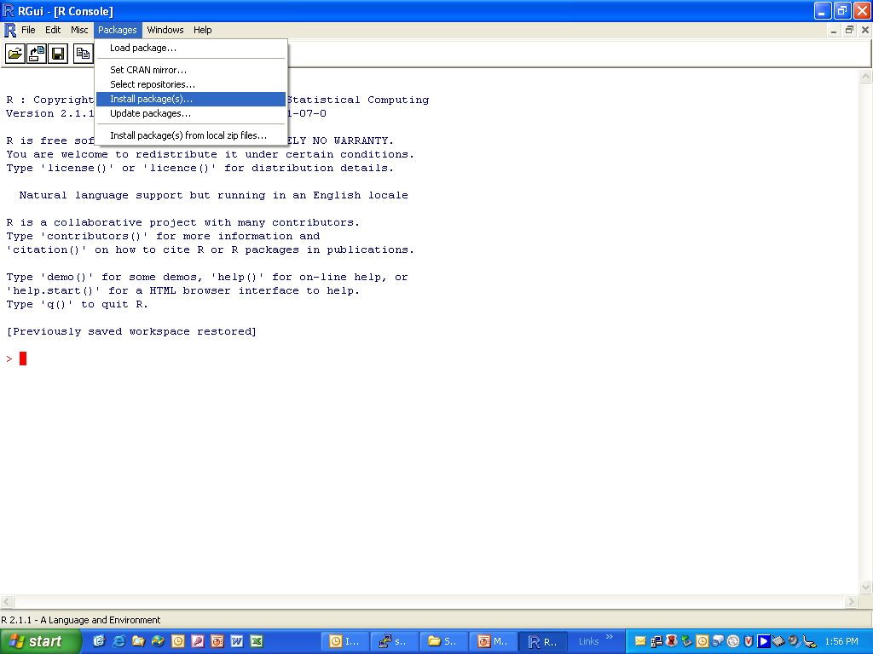
#Go to Packages, Install Packages, (select USA1, etc.) Bootstrap

Slide 58
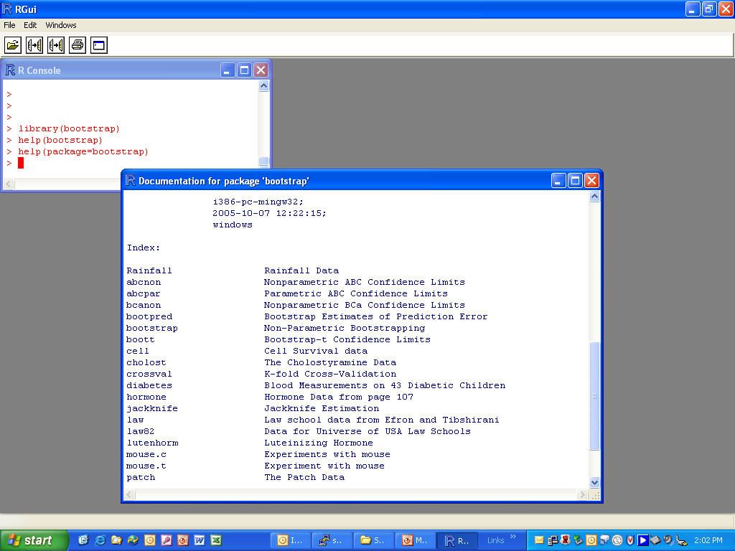

Slide 59
Problem Set 1- Fall 2016
Reading Assignment 1
Chapter 1. The Statistical Sleuth: A Course in Methods of Data Analysis. Ramsey & Schafer
Reading Assignment 2
An Introduction to R : http://cran.r-project.org/doc/manuals/R-intro.pdf
Consider the data set ChickWeight in R which gives Chicken Weights by Feed Type.
1. For the following, disregard the effect of Feed Type.
a) Perform EDA on the variable weight.
b) Estimate the bias associated with the sample standard deviation and median of weight using each of the following methods:
Jackknife
Bootstrap
2. Discuss the pros and cons of observational and controlled studies, giving illustrative examples.

